Slide 1

Chapter 2
Models and Migrations

Slide 2

Objectives
Start by creating a database using an open-source database visualization tool called SQLite DB Browser.
Perform some basic Create Read Update Delete (CRUD) database operations using SQL commands.
learn about Django's Object Relational Mapping (ORM).

Slide 3
Objectives
Learn about models and migrations, which are a part of Django's ORM, that are used to propagate database schematic changes from the application to the database.
Perform database CRUD operations, study the various types of database relationships and use that knowledge to perform queries across related records

Slide 4
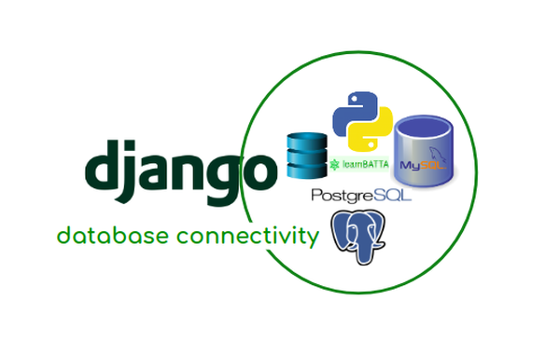
Introduction

Slide 5
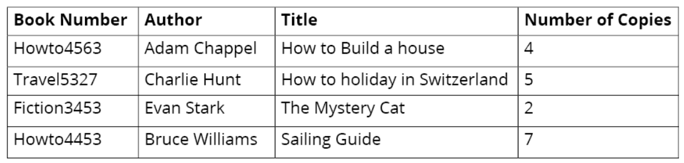
Introduction
A database looks like a spreadsheet or an Excel sheet containing records, with each table consisting of multiple rows and columns.

Slide 6
Databases
A database is a structured collection of data that helps manage information easily.
A software layer called the Database Management System (DBMS) is used to store, maintain, and perform operations on the data.
Databases are of two types, relational databases and non-relational databases.

Slide 7
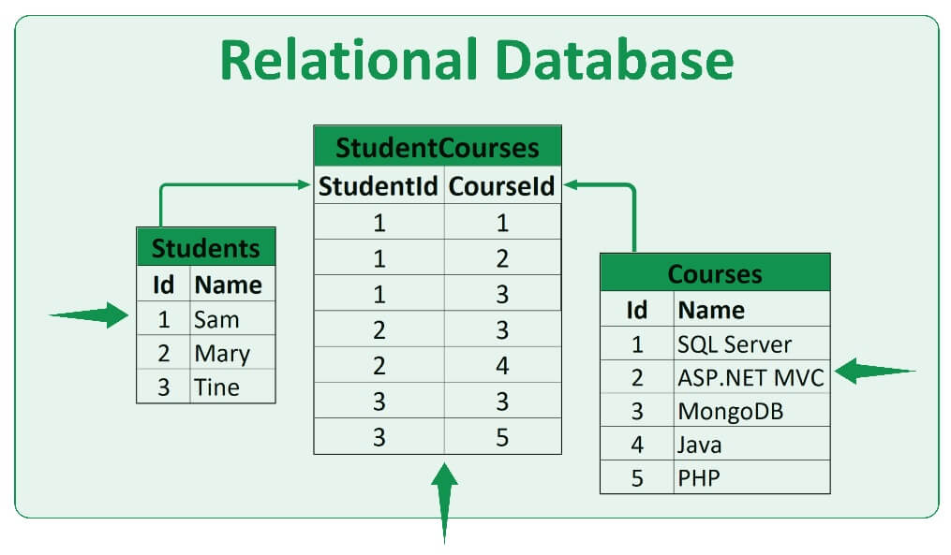

Slide 8
Relational Databases
Relational databases or Structured Query Language (SQL) databases store data in a pre-determined structure of rows and columns called tables.
A database can be made up of more than one such table, and these tables have a fixed structure of attributes, data types, and relations with other tables.

Slide 9
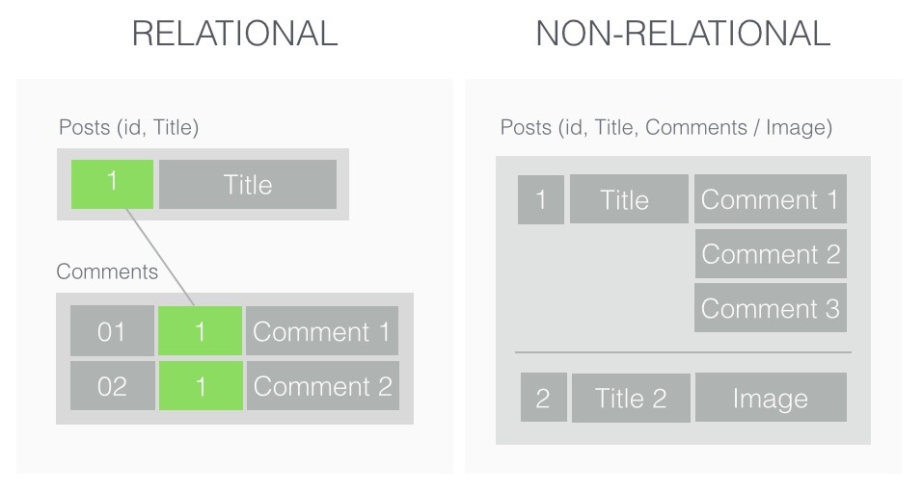

Slide 10
Non-Relational Databases
Non-relational databases or NoSQL (Not Only SQL) databases are designed to store unstructured data.
They are well suited to large amounts of generated data that does not follow rigid rules, as is the case with relational databases.

Slide 11
Database Operations Using SQL
SQL uses a set of commands to perform a variety of database operations, such as creating an entry, reading values, updating an entry, and deleting an entry.
These operations are collectively called CRUD operations, which stands for Create, Read, Update, and Delete.

Slide 12
Data Types in Relational databases
Databases provide us with a way to restrict the type of data that can be stored in a given column.
INTEGER is used for storing integers
TEXT can store text.
REAL is used for floating-point values

Slide 13
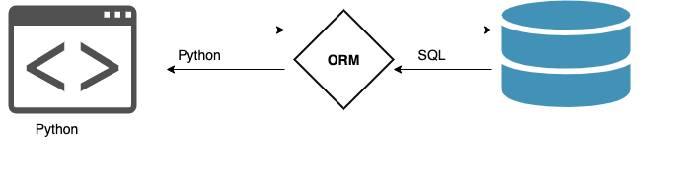
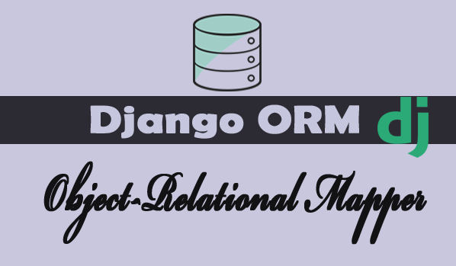
Django ORM

Slide 14
Django ORM
Django ORM converts object-oriented Python code into actual database constructs such as database tables with data type definitions and facilitates all the database operations via simple Python code.
This helps in faster application development and ease in maintaining the application source code.

Slide 15
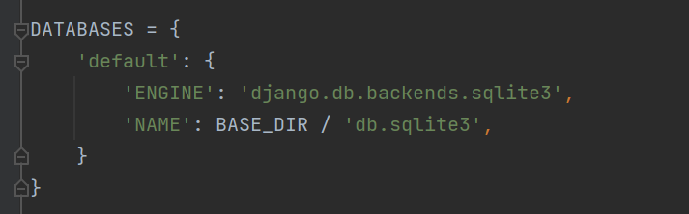
Database Configuration
Django project and run the Django server, the default database configuration is of SQLite3.

Slide 16
Database Configuration
The DATABASES variable is assigned with a dictionary containing the database details for the project.
The reason we have a nested dictionary with default as a key is that a Django project could potentially interact with multiple databases.

Slide 17
Database Configuration
The ENGINE key represents which database engine is being used; in this case, it is sqlite3.
The NAME key defines the name of the database, which can have any value.
BASE_DIR is the project directory as already defined in the settings.py

Slide 18
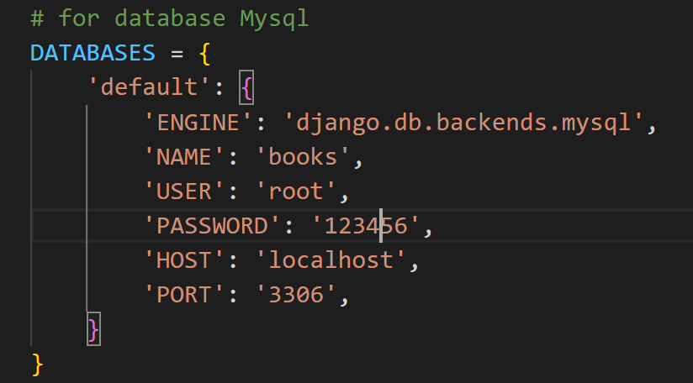
Database Configuration
Using other databases, such as PostgreSQL, MySQL, and so on, changes will have to be made in the preceding database settings as shown here:

Slide 19
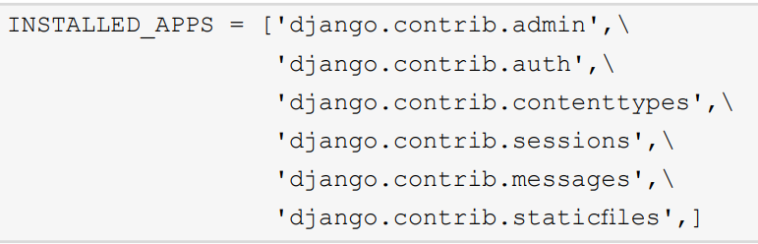
Django Apps
Django comes with the following apps enabled by default. The following is a snippet from a project's settings.py file:

Slide 20

Django Migration
The transformation of Python code into database structures is known as migration.
The following command should be entered in the terminal or shell to do this

Slide 21
Django Migration
Manage.py is a script that was automatically created when the project was created.
It is used for carrying out managerial or administrative tasks. By executing this command, we create all the database structures required by the installed apps.

Slide 22
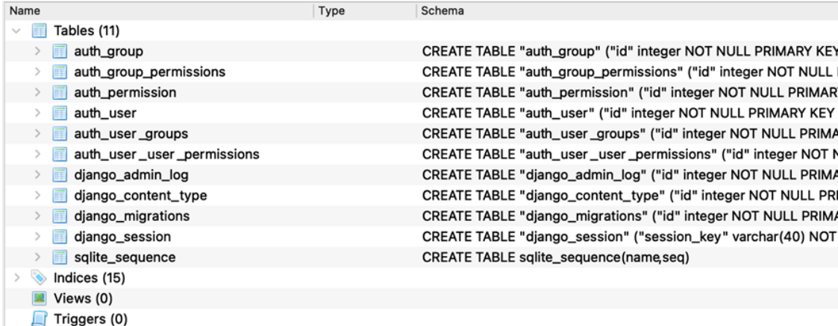
Django Migration
Contents of the db.sqlite3 file.

Slide 23
Creating Django Models and Migrations
The models.py file can have many such models, and each model transforms into a database table.
The attributes of the class form the fields and relationships of the database table as per the model definitions.

Slide 24
Creating Django Models and Migrations
A Django model is essentially a Python class that holds the blueprint for creating a table in a database.
The models.py file can have many such models, and each model transforms into a database table.
The attributes of the class form the fields and relationships of the database table as per the model definitions.

Slide 25
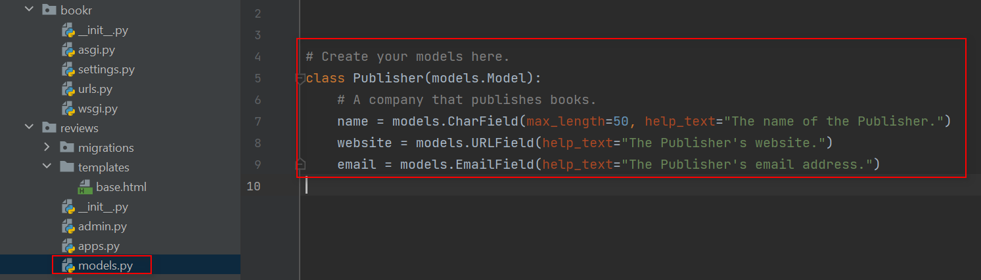
Creating Django Models and Migrations
Publisher model

Slide 26
Creating Django Models and Migrations
The first line of code imports the Django's models module. While this line will be autogenerated at the time of the creation of the Django app.
Following the import, the rest of the code is defining a class named Publisher, which will be a subclass of Django's models.

Slide 27
Field Types
CharField: This field type is used to store shorter string fields,
EmailField: This is similar to CharField, but validates whether the string represents a valid email address.
URLField: This is again similar to CharField, but validates whether the string represents a valid URL.

Slide 28
Field Types
These field options are used to set a value or a constraint, and so on.
We can set a default value for a field using default=<value>.

Slide 29
Field Types
help_text: This is a field option that helps us add descriptive text for a field that gets automatically included for Django forms.
max_length: This option is provided to CharField where it defines the maximum length of the field in terms of the number of characters.

Slide 30

Field Types
Execute the following command in the shell or terminal to do that (run it from the folder where your manage.py file is stored):

Slide 31

Field Types
The makemigrations<appname> command creates the migration scripts for the given app; in this case, for the reviews app

Slide 32
Primary Keys
While creating the Publisher table, the SQL CREATE TABLE command was adding one more field called id to the table. id is defined to be PRIMARY KEY AUTOINCREMENT.
A primary key is unique for a database table, and as a rule, a table cannot have two rows with the same primary key.

Slide 33
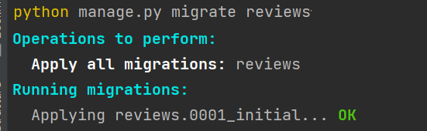
Primary Keys
migrate the newly created model in the reviews app by executing the following command.

Slide 34
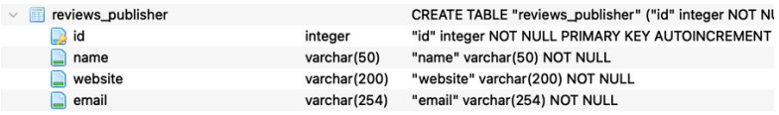
Primary Keys
This operation creates the database table for the reviews app.

Slide 35
Primary Keys
Book: This is the database table that holds the information about the book itself. We have already created a Book model and have migrated this to the database.
• Publisher: This table holds information about the book publisher.

Slide 36
Primary Keys
Contributor: This table holds information about the contributor, that is, the author, co-author, or editor.
Review: This table holds information about the review comments posted by the reviewers.

Slide 37
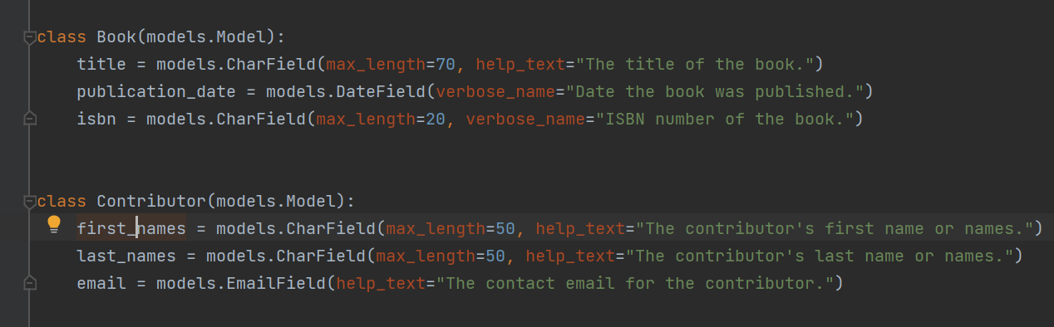
Primary Keys

Slide 38
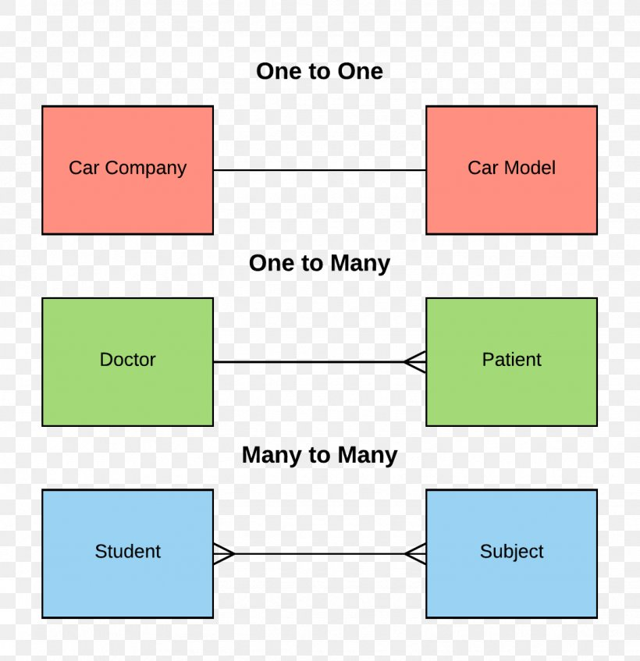
Relationships
In a relational database, there can be the following types of relations:
Many to one
Many to many
One to one

Slide 39
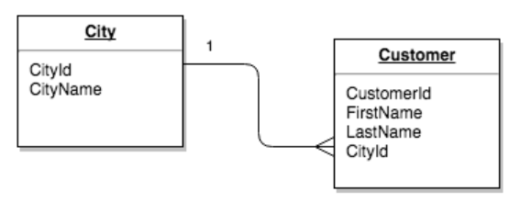
Many to One

Slide 40
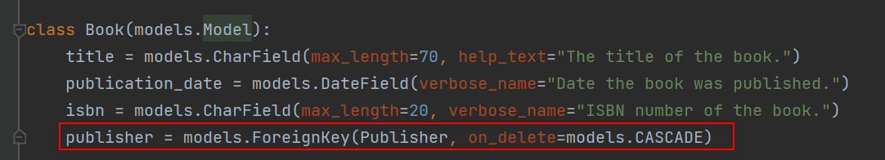
Many to One
In this relationship, many records (rows/entries) from one table can refer to one record (row/entry) in another table.

Slide 41
Many to One
models.ForeignKey: This is the field option to establish a many-toone relationship.
Publisher: When we establish relationships with different tables in Django, we refer to the model that creates the table; in this case, the Publisher table is created by the Publisher model (or the Python class Publisher).

Slide 42
Many to One
on_delete: This is a field option that determines the action to be taken upon the deletion of the referenced object. In this case, the on_delete option is set to CASCADE(models.CASCADE), which deletes the referenced objects.

Slide 43
Many to One
There are many more on_delete actions, such as the following:
PROTECT: This prevents the deletion of the record unless all the referenced objects are deleted.
SET_NULL: This sets a null value if the database field has been previously configured to store null values.
SET_DEFAULT: Sets to a default value on the deletion of the referenced object.

Slide 44
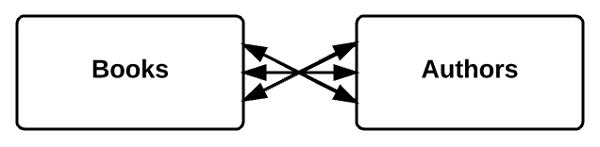
Many to Many

Slide 45
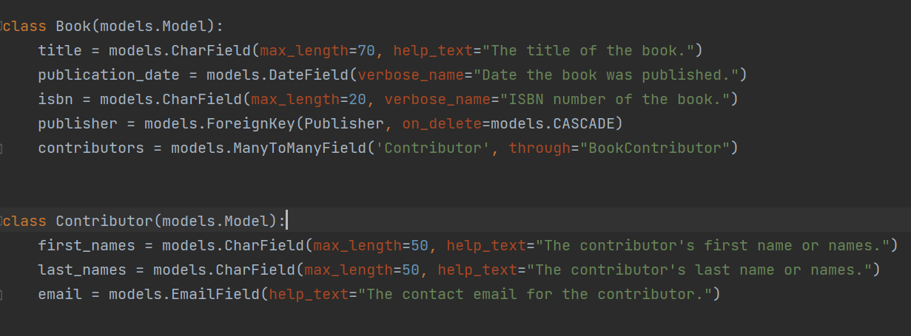
Many to Many

Slide 46
Many to Many
models.ManyToManyField: This is the field type to establish a many-tomany relationship.
through: This is a special field option for many-to-many relationships. When we have a many-to-many relationship across two tables.

Slide 47
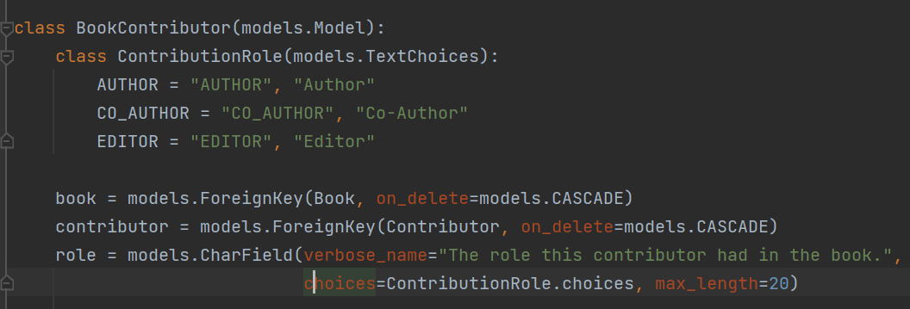
Many to Many

Slide 48
Many to Many
book: This is a foreign key to the Book model. As we saw previously, on_ delete=models.CASCADE will delete an entry from the relationship table when the relevant book is deleted from the application.

Slide 49
Many to Many
Contributor: This is again a foreign key to the Contributor model/table. This is also defined as CASCADE upon deletion
role: This is the field of the intermediary model, which stores the extra information about the relationship between Book and Contributor.

Slide 50
Many to Many
ContributionRole(models.TextChoices): This can be used to define a set of choices by creating a subclass of models.TextChoices. For example, ContributionRole is a subclass created out of TextChoices, which is used by the roles field to define Author, Co-Author, and Editor as a set of choices.

Slide 51
Many to Many
choices: This refers to a set of choices defined in the models, and they are useful when creating Django Forms using the models.

Slide 52
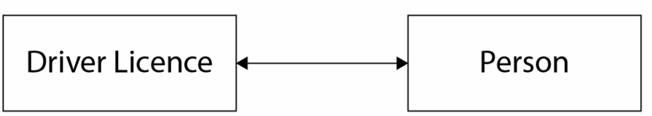
One-to-One Relationships

Slide 53
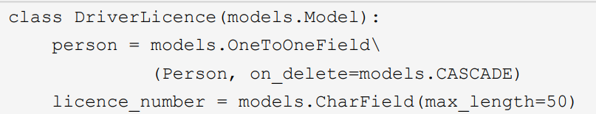
One-to-One Relationships
In this relationship, one record in a table will have a reference to only one record in a different table.

Slide 54
Model Methods
In Django, we can write methods inside a model class. These are called model methods and they can be custom methods or special methods that override the default methods of Django models.

Slide 55
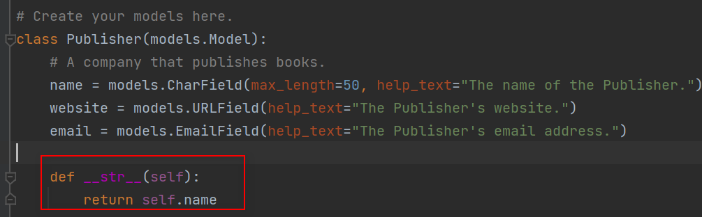
Model Methods
the __str__ () method is added to the Publisher model, the string representation of the Publisher object will be the publisher's name.

Slide 56
Migrating the Reviews App

Slide 57
Migrating the Reviews App
Migration scripts help in identifying any changes to the models and will propagate these changes into the database while running the migration.

Slide 58
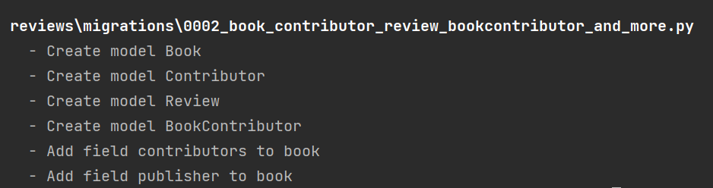
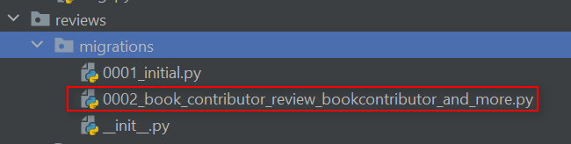
Migrating the Reviews App

Slide 59

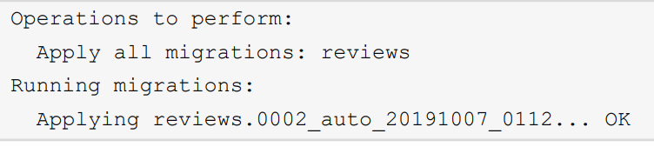
Migrating the Reviews App
Migrate all the models into the database using the migrate command:

Slide 60
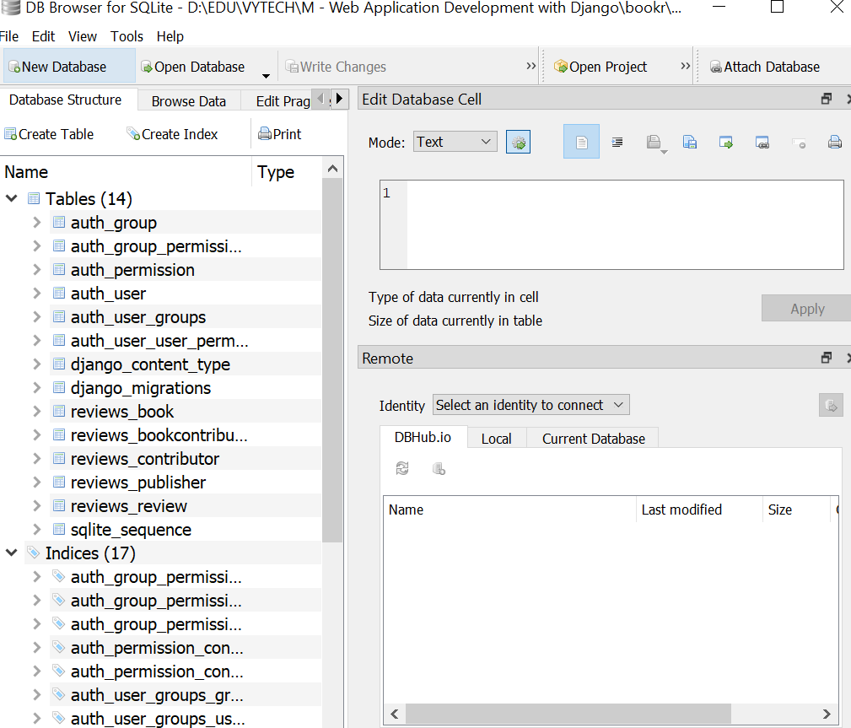
Migrating the Reviews App

Slide 61
Django's Database CRUD Operations

Slide 62

Django's Database CRUD Operations
Django's ORM provides the same functionality without having to deal with the SQL statements.
To execute the CRUD operations, we will enter Django's command-line shell by executing the following command:

Slide 63
Creating an Object with a Foreign Key

Slide 64
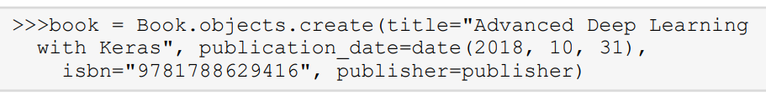
Creating an Object with a Foreign Key
Book table where the first entry is created. Notice that the foreign key field (publisher_id ) points to the id (primary key) of the Publisher table.

Slide 65
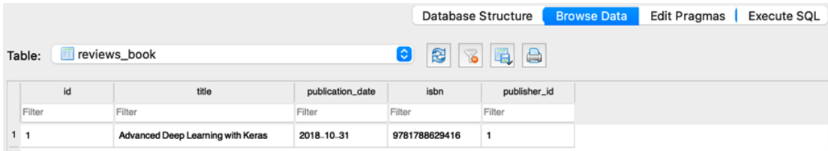
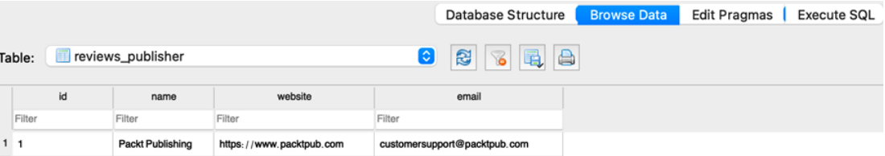
Creating an Object with a Foreign Key

Slide 66
Creating Records with Many-to-Many Relationships

Slide 67
Creating Records with Many-to-Many Relationships
The way to establish a many-to-many relationship is by storing the information about the relationship in the intermediary model or the relationship model;

Slide 68
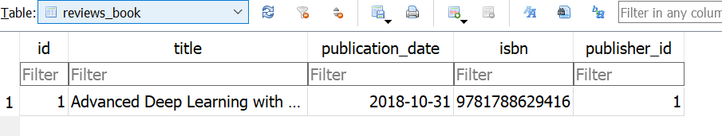
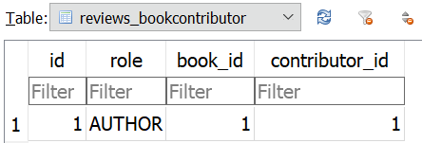
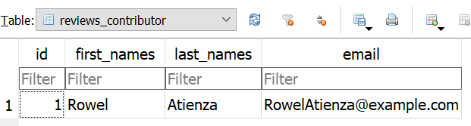
Creating Records with Many-to-Many Relationships

Slide 69
Creating Records with Many-to-Many Relationships
Using create() and set() Methods for Many-to-Many Relationships
If the contributor is not already present in the database, then we can use the create()

Slide 70
Read Operations
Django provides us with methods that allow us to read/retrieve from the database. We can retrieve a single object from the database using the get() method. We have already created a few records in the previous sections, so let's use the get() method to retrieve an object.

Slide 71

Read Operations
Exercise 2.07: Using the get() Method to Retrieve an Object

Slide 72


Returning an Object Using the get() Method
After retrieving the object, we can still get the publisher's name, as shown here.

Slide 73
Retrieving Objects by Filtering
If we have more than one object for a field value, then we cannot use the get() method since the get() method can return only one object. For such cases, we have the filter() method, which can retrieve all the objects that match a specified condition.

Slide 74
Filtering by Field Lookups
Here, publication_date__gt indicates the publication date, which is greater than (gt) a certain specified date.
lt: Less than
lte: Less than or equal to
gte: Greater than or equal to

Slide 75

Using Pattern Matching for Filtering Operations
For filtered results, we can also look up whether the parameter contains a part of the string we are looking for.

Slide 76
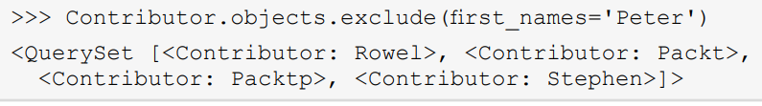
Retrieving Objects by Excluding
we can use the exclude() method to exclude a certain condition and fetch all the required objects

Slide 77
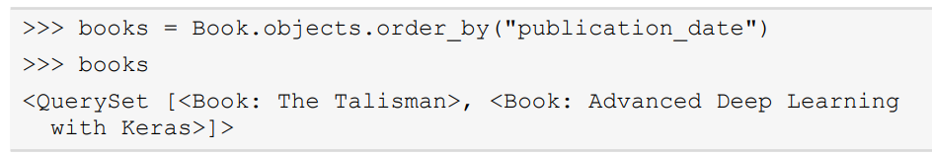
Retrieving Objects Using the order_by() Method
We can retrieve a list of objects while ordering by a specified field, using the order_ by() method.

Slide 78
Querying Across Relationships

Slide 79
Querying Using Foreign Keys
When we have relationships across two models/tables, Django provides a way to perform a query using the relationship

Slide 80
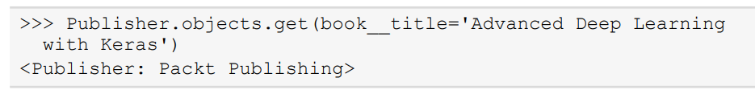
Querying Using Model Name
Another way of querying is where we can use a relationship to do the query backward, using the model name in lowercase.

Slide 81
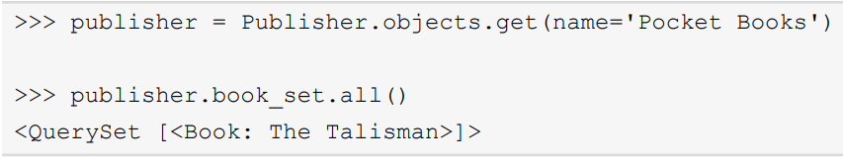
Using the Object Instance
Using the object here is an example where we use the reverse direction to get all the books published by a publisher by using the set.all() method:

Slide 82
Summary
We learned about some basic database concepts and their importance in application development.
We used a free database visualization tool, DB Browser for SQLite.
Django provides a valuable abstraction layer called ORM that helps us interact seamlessly with relational databases.

Slide 83
The End.

